Slide 1
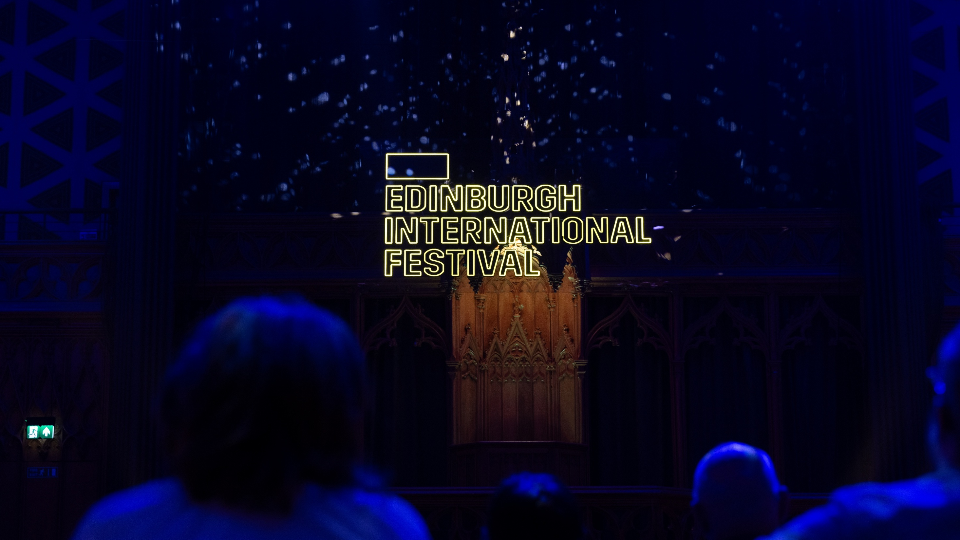

Slide 2

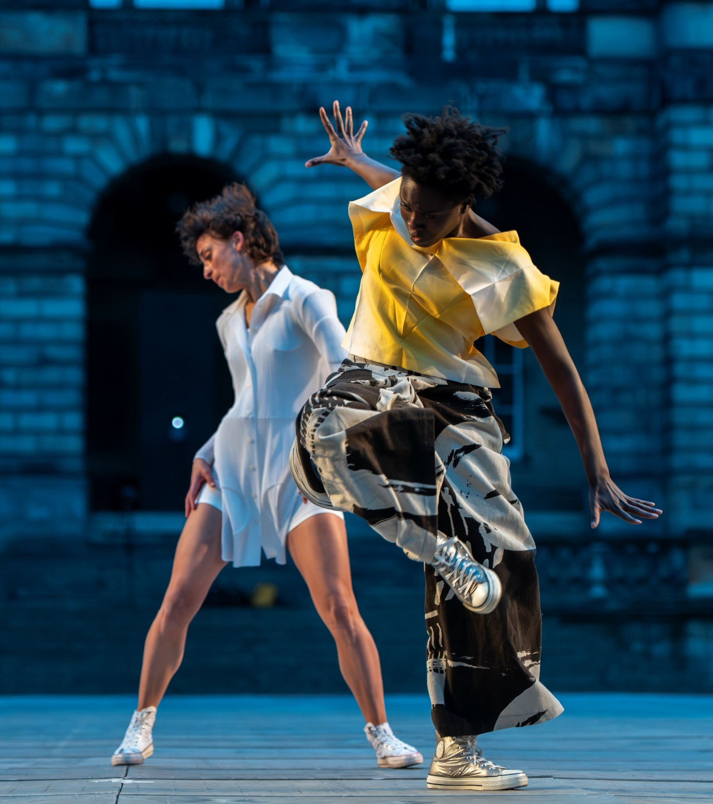
The Original Festival
The original festival. We’re the one that started it all, the igniting spark which established Edinburgh as the world’s Festival City. Edinburgh International Festival has been a window to the world since 1947. Our founder, cultural pioneer and refugee Rudolf Bing, set out to bring the global stage to the centre of Edinburgh in the spirit of reconciliation.
Now, eight decades on, we’re still dedicated to bringing the deepest experience of the highest quality art to the widest possible audience.
Dance People © Tommy Ga-Ken Wan

Slide 3
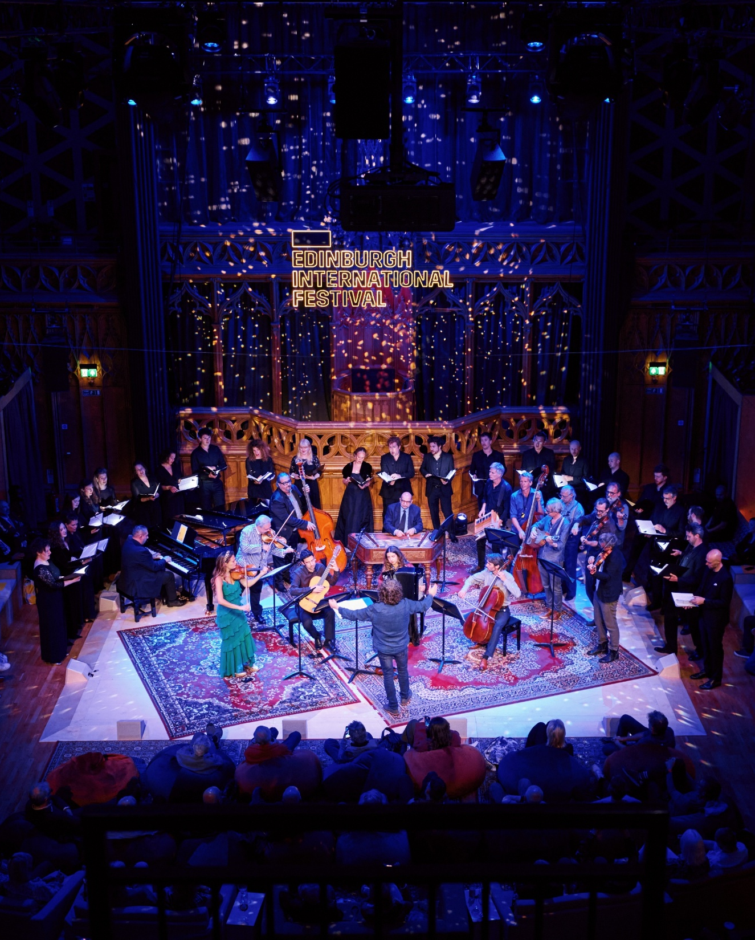
Olympic scale, every year
With over 700,000 visitors passing through Edinburgh during August, your business could have brand exposure on the scale of the Olympics, every single year.
125,000
2,400+
Global audience members
Loyal members
250,000+
7 billion
Engaged social followers
Global press impressions
25+
90,000
Visiting international delegations
Festival brochures and guides distributed
First Night at the Hub © Andrew Parry
As of June 2026
Notes:
7 billion global press impressions
X number of brochures

Slide 4
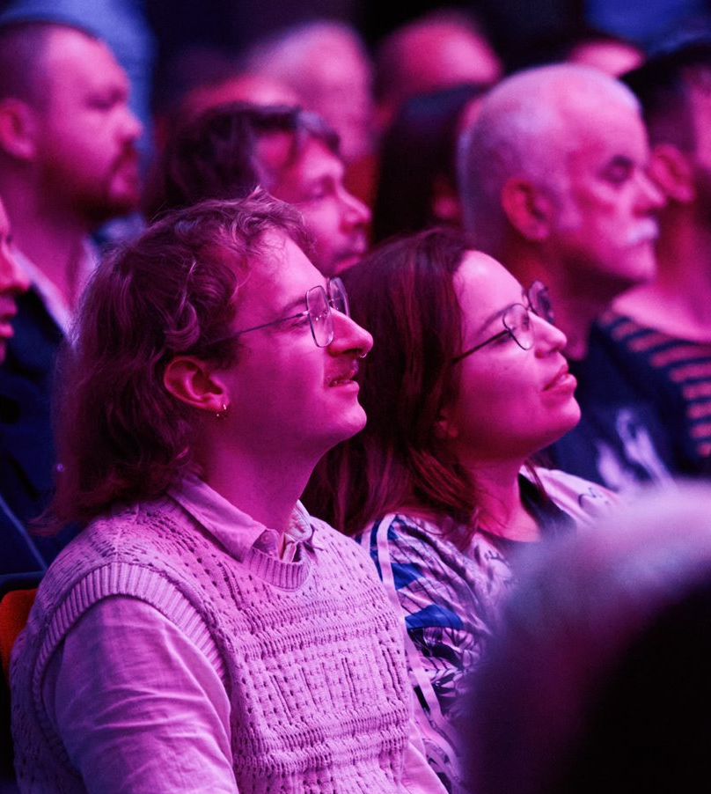
Pathways to Partnership
We work collaboratively with you to build bespoke partnerships tailored to your organisation's needs.
Let us help you boost your brand visibility, deliver unforgettable hospitality packages, and support your CSR objectives.
With our far-reaching, global audience and our established base of loyal supporters, we have a captive audience waiting for you.

Slide 5
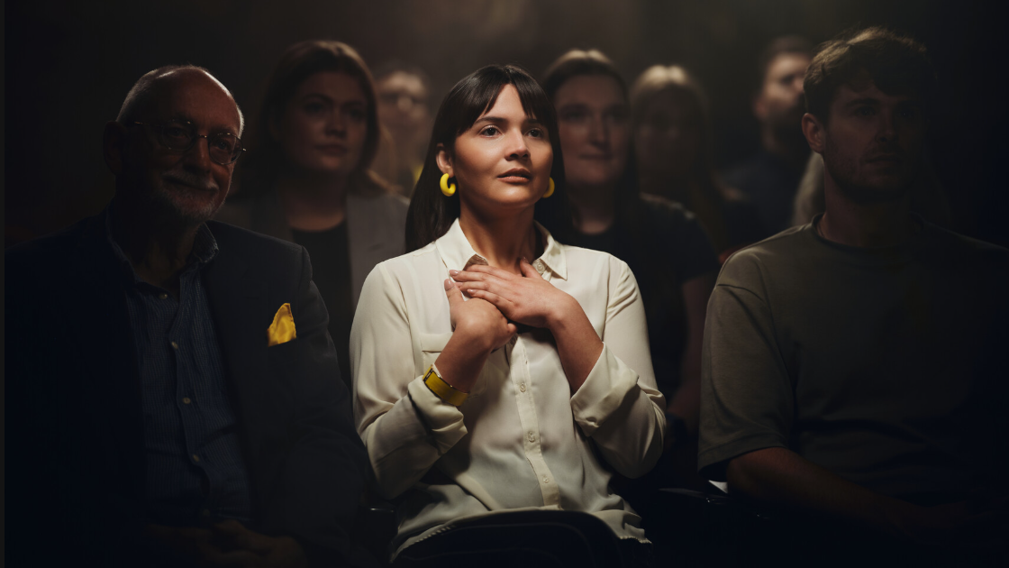

Ally Steel
Head of Partnerships
E ally.steel@eif.co.uk

